Slide 1



TCS Stock Data Analysis and Prediction
This presentation will explore the use of machine learning techniques to analyze and predict TCS stock performance.
by Dhruv Singh
Notes:
1

Slide 2


Introduction to the Project
Our goal is to forecast future stock prices and identify potential opportunities.
We will examine TCS stock data to understand historical trends and patterns.
We'll utilize Machine Learning models to predict the stock price movement.
Notes:
2

Slide 3

Technologies & Tools
Python is the main programming language used for this project.
1
We leverage various Python libraries including Pandas, NumPy, Matplotlib, Seaborn, and Scikit-learn.
2
3
Data analysis is performed using SQL and Excel.
4
The Linear Regression model is used for predicting stock price trends.
Notes:
3

Slide 4


Dataset Overview
The dataset contains historical TCS stock data sourced from reputable financial websites.
Key columns :-
Date – Trading date
Open – Opening stock price
High – Highest stock price of the day
Low – Lowest stock price of the day
Close – Closing stock price
Volume – Number of shares traded
Dividends – Dividends paid on the stock
Stock Splits – Number of stock splits
Notes:
4

Slide 5



Data Cleaning & Preprocessing
Missing values are handled using a forward-fill method to ensure data consistency.
Numerical columns are standardized to remove anomalies and prepare data for analysis.
We perform feature engineering by adding moving averages and lag variables for trend analysis.
Notes:
5

Slide 6
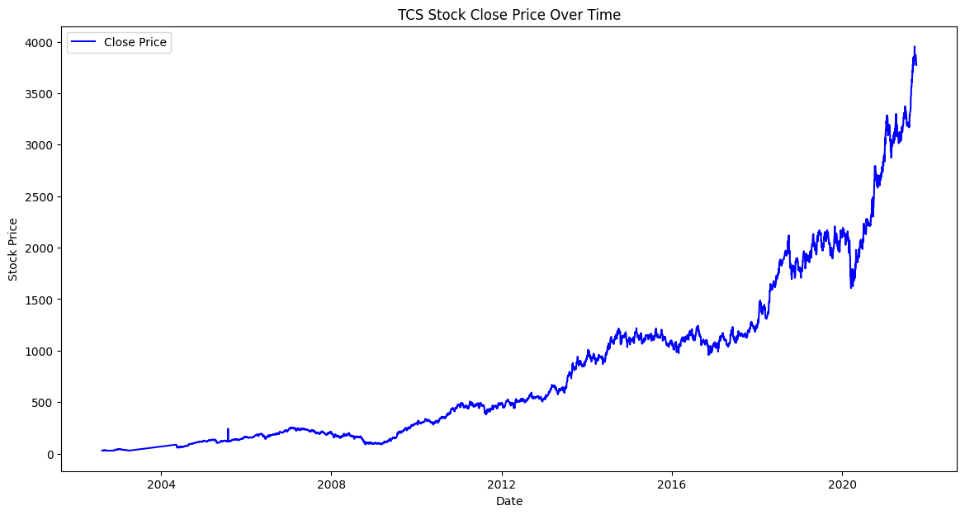
Stock Close Price Over Time
We analyzed historical TCS stock price data to identify trends and patterns.
The analysis revealed price spikes and other noteworthy patterns.
Notes:
6

Slide 7
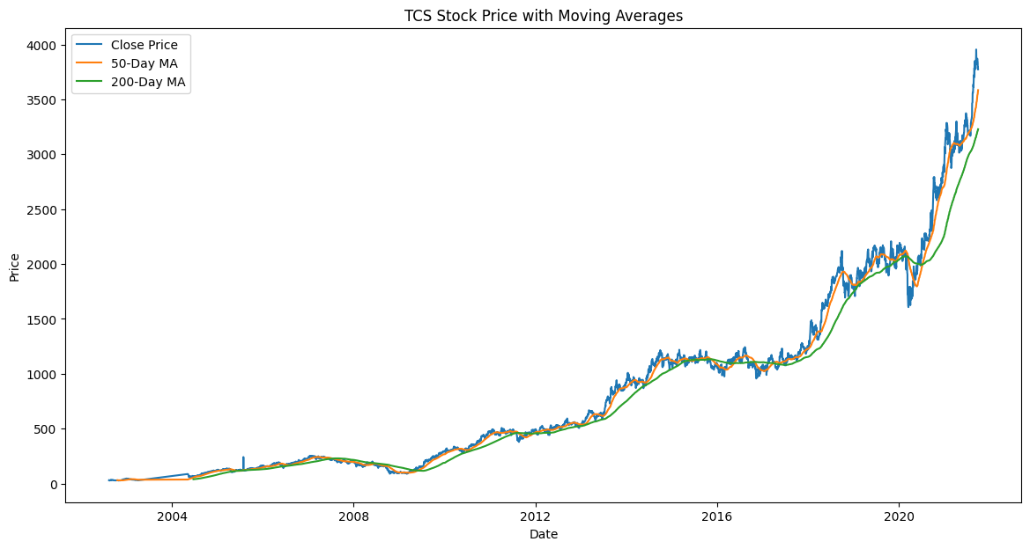
Stock Price with Moving Averages
Key Insight: Moving average crossovers indicate bullish/bearish trends.
Notes:
6

Slide 8

Creating New Features for Analysis
New features were extracted from the dataset, such as year, month, day, and day of the week.
Lag variables were created to analyze the relationship between current and previous stock prices.
Notes:
7

Slide 9
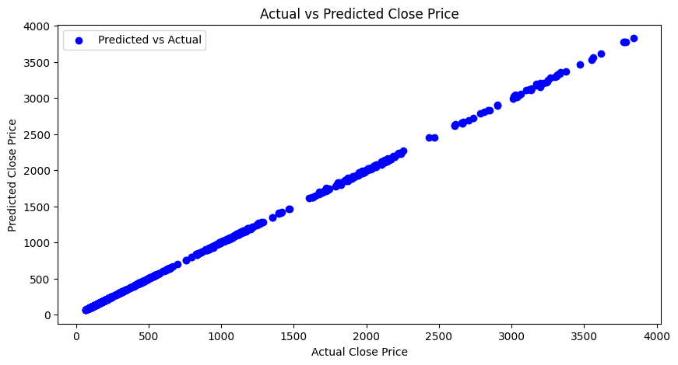
Actual vs Predicted Close Price
Notes:
6

Slide 10
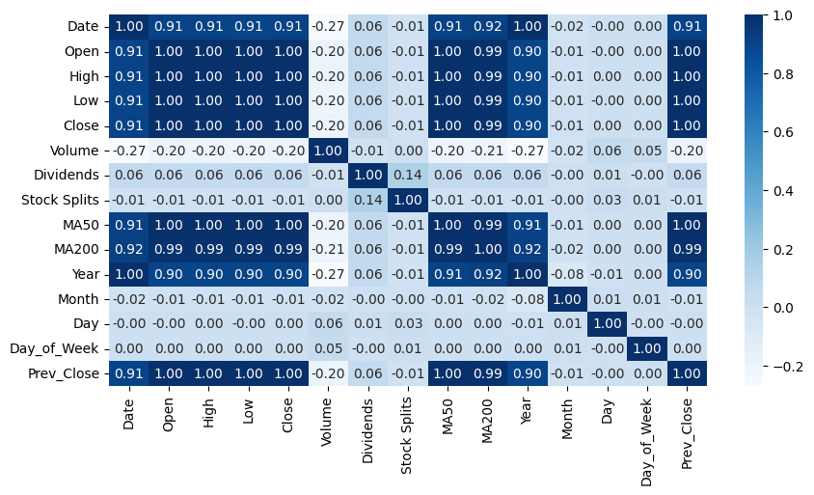
Correlation of features with the target variable
Notes:
6

Slide 11
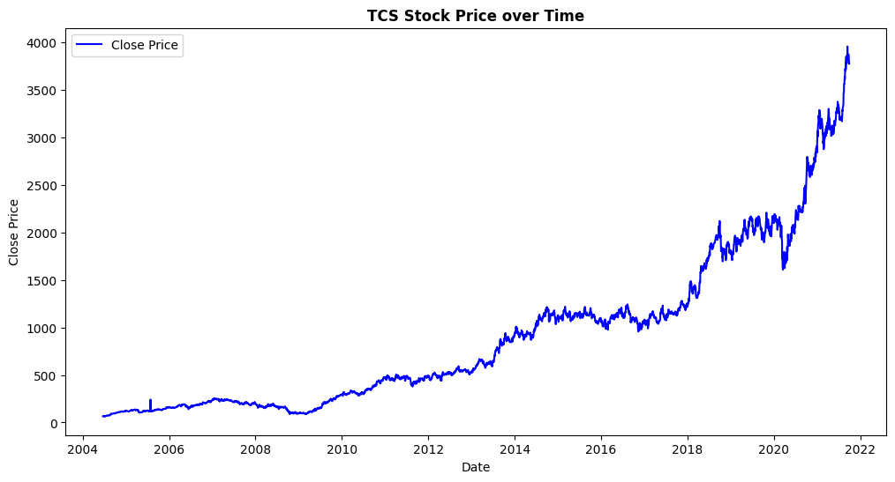
TCS Stock Price over Time
Notes:
6

Slide 12
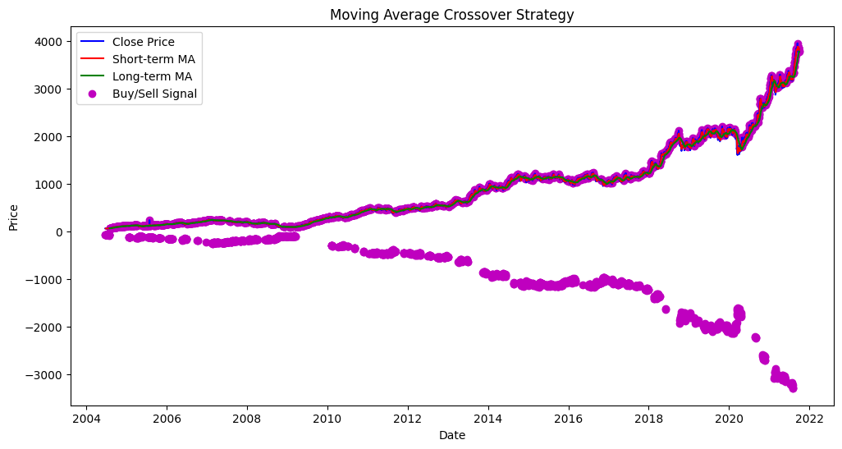
Moving Average Crossover Strategy
Notes:
6

Slide 13



Evaluating Model Performance
The MSE of the model was 39.04992998516231.
The R-Squared score of the model was 0.9999438356582193.
Notes:
9

Slide 14

Enhancing Predictive Capabilities
Consider using advanced machine learning models like Random Forest and XGBoost.
1
Hyperparameter tuning can optimize the performance of the chosen ML model.
2
Implement Time-Series Analysis techniques like ARIMA for more accurate trend predictions.
3
Notes:
10

Slide 15
Key Takeaways
1
Successful Analysis
2
Data-Driven Insights
3
Future Directions
We successfully analyzed historical TCS stock price trends and identified key patterns.
Moving averages and historical data proved valuable in providing actionable insights.
Future work will focus on implementing advanced machine learning models for improved predictions.
Notes:
11

Slide 16

Thank You

Slide 17

CONTACT
Me
Email : ds075156@gmail.com
LinkedIn : https://www.linkedin.com/in/dhruvsingh-data-analyst/
GitHub : https://github.com/dhru07/TCS_Stock_Data_Analysis_UM

